Slide 1


Introducing Economics

Slide 2
Introducing Economics
What do Economists Study?

Slide 3
WHAT DO ECONOMISTS STUDY?
Economic problems
  production and consumption
Scarcity: the central economic problem
  defining scarcity
  use of resources (factors of production)
    labour
    land and raw materials
    capital
  demand and supply
    importance of reconciling demand and supply
    actual and potential demand and supply
Notes:
2

Slide 4
WHAT DO ECONOMISTS STUDY?
Macroeconomic issues
  growth
  unemployment
  inflation
  balance of payments problems
  cyclical fluctuations
Notes:
3

Slide 5
WHAT DO ECONOMISTS STUDY?
Microeconomic issues
  choices: what, how and for whom
  the concept of opportunity cost
  rational economic decision making
    marginal costs and marginal benefits
    MC > MB → do more
    MC > MB → do less
  microeconomic objectives
    efficiency
    equity
Notes:
3

Slide 6
WHAT DO ECONOMISTS STUDY?
The production possibility curve
  what the curve shows
Notes:
4

Slide 7

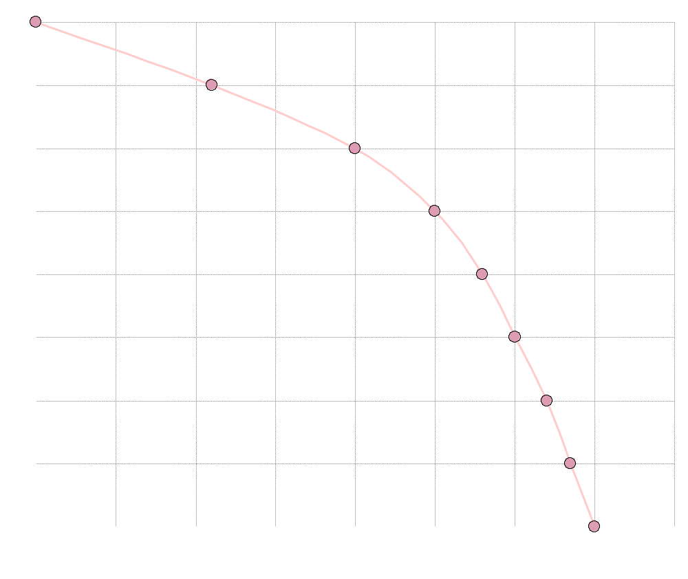

A production possibility curve
Units of food Units of clothing
(millions) (millions)
8m 0.0
7m 2.2m
6m 4.0m
5m 5.0m
4m 5.6m
3m 6.0m
2m 6.4m
1m 6.7m
0 7.0m
Units of food (millions)
Units of clothing (millions)

Slide 8
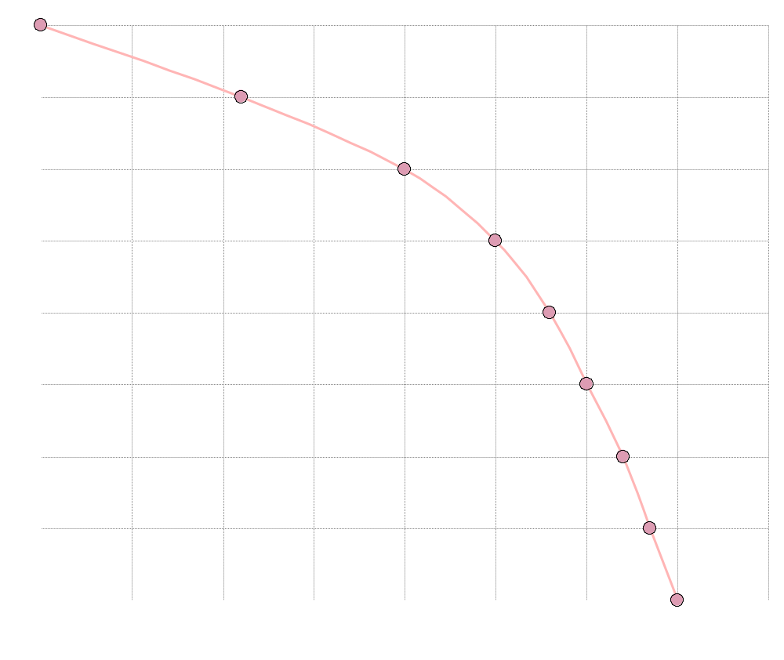
A production possibility curve
a
Units of food Units of clothing
(millions) (millions)
a 8m 0.0
7m 2.2m
6m 4.0m
5m 5.0m
4m 5.6m
3m 6.0m
2m 6.4m
1m 6.7m
0 7.0m
Units of food (millions)
Units of clothing (millions)

Slide 9
A production possibility curve
b
Units of food Units of clothing
(millions) (millions)
8m 0.0
b 7m 2.2m
6m 4.0m
5m 5.0m
4m 5.6m
3m 6.0m
2m 6.4m
1m 6.7m
0 7.0m
Units of food (millions)
Units of clothing (millions)

Slide 10
A production possibility curve
c
Units of food Units of clothing
(millions) (millions)
8m 0.0
7m 2.2m
c 6m 4.0m
5m 5.0m
4m 5.6m
3m 6.0m
2m 6.4m
1m 6.7m
0 7.0m
Units of food (millions)
Units of clothing (millions)

Slide 11
A production possibility curve
Units of food Units of clothing
(millions) (millions)
8m 0.0
7m 2.2m
6m 4.0m
5m 5.0m
4m 5.6m
3m 6.0m
2m 6.4m
1m 6.7m
0 7.0m
Units of food (millions)
Units of clothing (millions)

Slide 12

A production possibility curve
Units of food (millions)
Units of clothing (millions)

Slide 13
A production possibility curve
w
x
Units of food (millions)
Units of clothing (millions)

Slide 14
WHAT DO ECONOMISTS STUDY?
The production possibility curve
  what the curve shows
  microeconomics and the production possibility curve:
Notes:
4

Slide 15
WHAT DO ECONOMISTS STUDY?
The production possibility curve
  what the curve shows
  microeconomics and the production possibility curve:
    choices and opportunity cost
Notes:
4

Slide 16
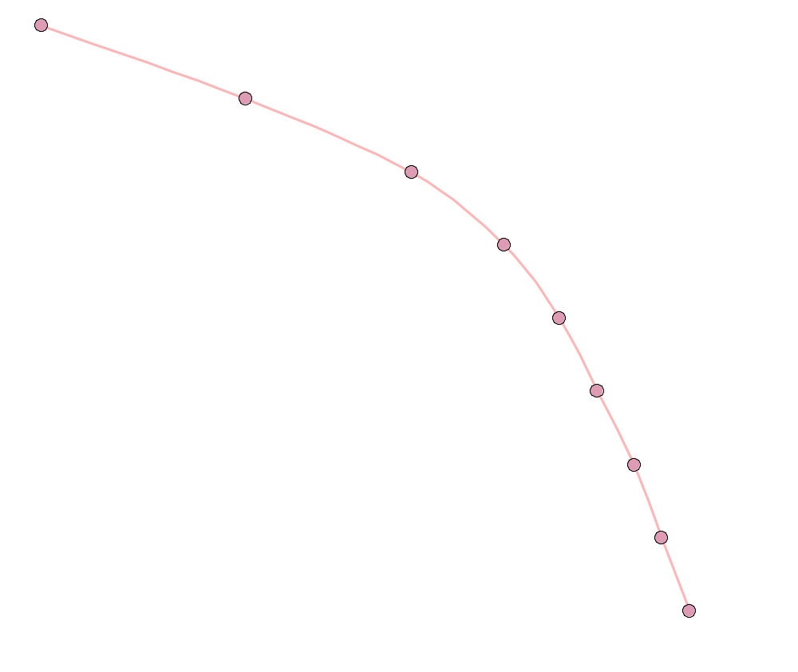

Opportunity cost
x
1
y
1
Units of food (millions)
Units of clothing (millions)

Slide 17
WHAT DO ECONOMISTS STUDY?
The production possibility curve
  what the curve shows
  microeconomics and the production possibility curve:
    choices and opportunity cost
    increasing opportunity cost
Notes:
4

Slide 18
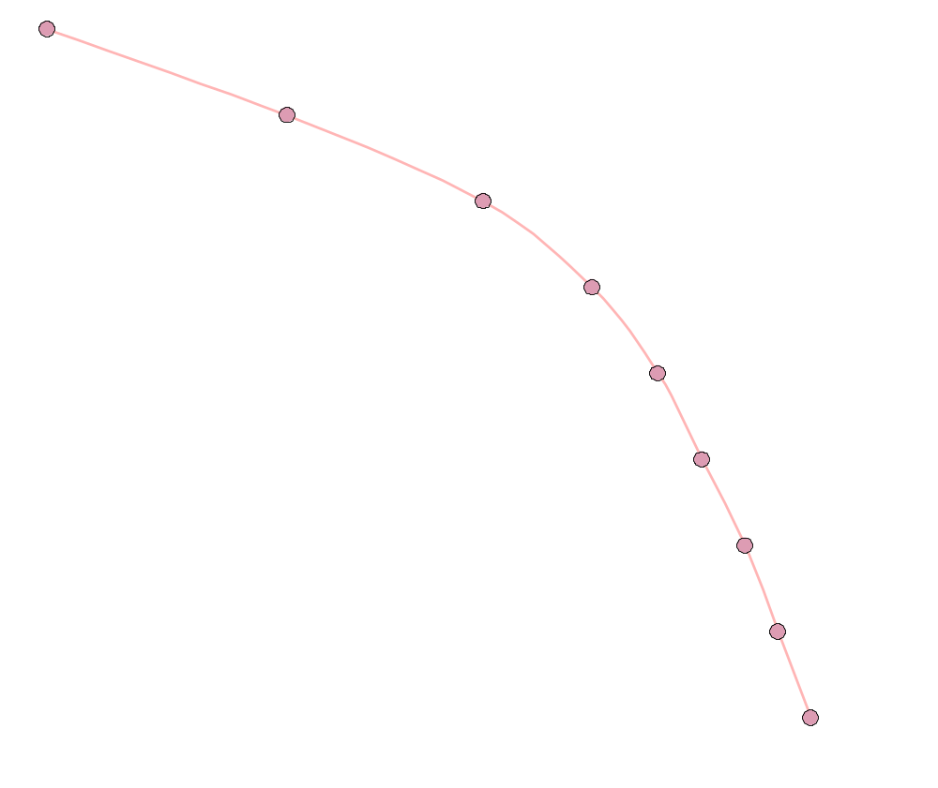

Increasing opportunity costs
x
1
y
1
Units of food (millions)
2
z
1
Units of clothing (millions)

Slide 19
WHAT DO ECONOMISTS STUDY?
The production possibility curve
  what the curve shows
  microeconomics and the production possibility curve:
    choices and opportunity cost
    increasing opportunity cost
  macroeconomics and the production possibility curve:
Notes:
4

Slide 20
WHAT DO ECONOMISTS STUDY?
The production possibility curve
  what the curve shows
  microeconomics and the production possibility curve:
    choices and opportunity cost
    increasing opportunity cost
  macroeconomics and the production possibility curve:
    production within the curve
Notes:
4

Slide 21

Making a fuller use of resources
x
Production inside
the production
possibility curve
y
Food
v
O
Clothing

Slide 22
WHAT DO ECONOMISTS STUDY?
The production possibility curve
  what the curve shows
  microeconomics and the production possibility curve:
    choices and opportunity cost
    increasing opportunity cost
  macroeconomics and the production possibility curve:
    production within the curve
    shifts in the curve
Notes:
4

Slide 23

Growth in potential output
Food
Now
O
Clothing

Slide 24

Growth in potential output
5 years’ time
Food
Now
O
Clothing

Slide 25

Growth in potential and actual output
Food
O
Clothing

Slide 26

Growth in potential and actual output
y
x
Food
O
Clothing

Slide 27
WHAT DO ECONOMISTS STUDY?
The circular flow of income
  firms and households
Notes:
5

Slide 28
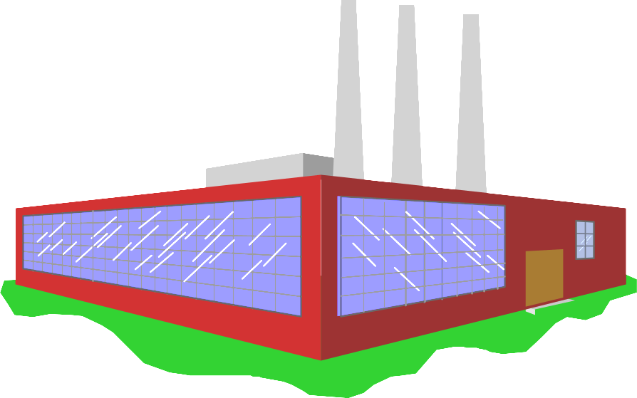

The circular flow of goods and incomes

Slide 29
WHAT DO ECONOMISTS STUDY?
The circular flow of income
  firms and households
  real and money flows
Notes:
5

Slide 30
The circular flow of goods and incomes

Slide 31
The circular flow of goods and incomes
Goods and services

Slide 32
The circular flow of goods and incomes
Goods and services
£
Consumer
expenditure

Slide 33
The circular flow of goods and incomes
Goods and services
£
Consumer
expenditure
Services of factors of production (labour, etc)

Slide 34
The circular flow of goods and incomes
Goods and services
£
Consumer
expenditure
Wages, rent
dividends, etc.
£
Services of factors of production (labour, etc)

Slide 35
WHAT DO ECONOMISTS STUDY?
The circular flow of income
  firms and households
  real and money flows
  goods and factor markets
Notes:
5

Slide 36
The circular flow of goods and incomes
Goods and services
£
Consumer
expenditure
GOODS MARKETS
FACTOR MARKETS
Wages, rent
dividends, etc.
£
Services of factors of production (labour, etc)

Slide 37
WHAT DO ECONOMISTS STUDY?
The circular flow of income
  firms and households
  real and money flows
  goods and factor markets
  macroeconomics: the total flows
Notes:
5

Slide 38
The circular flow of goods and incomes
Goods and services
£
Consumer
expenditure
GOODS MARKETS
FACTOR MARKETS
Wages, rent
dividends, etc.
£
Services of factors of production (labour, etc)

Slide 39
WHAT DO ECONOMISTS STUDY?
The circular flow of income
  firms and households
  real and money flows
  goods and factor markets
  macroeconomics: the total flows
  microeconomics: individual markets
Notes:
5

Slide 40
The circular flow of goods and incomes
Goods and services
£
Consumer
expenditure
GOODS MARKETS
FACTOR MARKETS
Wages, rent
dividends, etc.
£
Services of factors of production (labour, etc)

Slide 41
Introducing Economics
Economic Systems

Slide 42
ECONOMIC SYSTEMS
Classifying economic systems
  methods of classification
  classification by degree of government control
Notes:
6

Slide 43

Classifying economic systems
Totally
planned
economy
Totally
free-market
economy

Slide 44
Classifying economic systems
Mid 1980s
N. Korea
China
UK
Hong
Kong
Cuba
Poland
France
USA
Totally
planned
economy
Totally
free-market
economy

Slide 45
Classifying economic systems
Mid 1980s
N. Korea
China
UK
Hong
Kong
Cuba
Poland
France
USA
Totally
planned
economy
Totally
free-market
economy
N. Korea
Cuba
China
Poland
France
USA
UK
China
(Hong
Kong)
Mid 2000s

Slide 46
ECONOMIC SYSTEMS
Classifying economic systems
  methods of classification
  classification by degree of government control
  other methods of classification
Notes:
6

Slide 47
ECONOMIC SYSTEMS
Classifying economic systems
  methods of classification
  classification by degree of government control
  other methods of classification
The command economy
Notes:
6

Slide 48
ECONOMIC SYSTEMS
Classifying economic systems
  methods of classification
  classification by degree of government control
  other methods of classification
The command economy
  features of a command economy
Notes:
6

Slide 49
ECONOMIC SYSTEMS
Classifying economic systems
  methods of classification
  classification by degree of government control
  other methods of classification
The command economy
  features of a command economy
  planning:
Notes:
6

Slide 50
ECONOMIC SYSTEMS
Classifying economic systems
  methods of classification
  classification by degree of government control
  other methods of classification
The command economy
  features of a command economy
  planning:
    consumption and investment
Notes:
6

Slide 51
ECONOMIC SYSTEMS
Classifying economic systems
  methods of classification
  classification by degree of government control
  other methods of classification
The command economy
  features of a command economy
  planning:
    consumption and investment
    matching of inputs and outputs
Notes:
6

Slide 52
ECONOMIC SYSTEMS
Classifying economic systems
  methods of classification
  classification by degree of government control
  other methods of classification
The command economy
  features of a command economy
  planning:
    consumption and investment
    matching of inputs and outputs
    distribution of output
Notes:
6

Slide 53
ECONOMIC SYSTEMS
Advantages of a command economy
  high investment, high growth
  stable growth
  social goals pursued
  low unemployment
Problems of a command economy
  problems of gathering information
  expensive to administer
  inappropriate incentives
  shortages and surpluses
Notes:
8

Slide 54
ECONOMIC SYSTEMS
The free-market economy
  demand and supply decisions
  the price mechanism:
    shortages and surpluses
    equilibrium price
    response to changes in demand and supply
Notes:
9

Slide 55
The price mechanism:
the effect of a rise in demand
Goods Market
S_{g}
↑
D_{g}
shortage
(D_{g} > S_{g})
P_{g}
until D_{g} = S_{g}
↑
↑
D_{g}
↓

Slide 56
The price mechanism:
the effect of a rise in demand
Goods Market
S_{g}
↑
D_{g}
shortage
(D_{g} > S_{g})
P_{g}
until D_{g} = S_{g}
↑
↑
D_{g}
↓
Factor Market
S_{f}
↑
S_{g}
D_{f}
shortage
(D_{f} > S_{f})
P_{f}
↑
↑
↑
until D_{f} = S_{f}
D_{f}
↓

Slide 57
ECONOMIC SYSTEMS
The free-market economy
  demand and supply decisions
  the price mechanism:
    shortages and surpluses
    equilibrium price
    response to changes in demand and supply
  the interdependence of markets
Notes:
9

Slide 58
The price mechanism:
the effect of a rise in demand
Goods Market
S_{g}
↑
D_{g}
shortage
(D_{g} > S_{g})
P_{g}
until D_{g} = S_{g}
↑
↑
D_{g}
↓
Factor Market
S_{f}
↑
S_{g}
D_{f}
shortage
(D_{f} > S_{f})
P_{f}
↑
↑
↑
until D_{f} = S_{f}
D_{f}
↓

Slide 59
ECONOMIC SYSTEMS
Advantages of a free-market economy
  transmits information between buyers and sellers
  no need for costly bureaucracy
  incentives to be efficient
  competitive markets responsive to consumers
Notes:
9

Slide 60
ECONOMIC SYSTEMS
Problems of a free-market economy
  competition may be limited: problem of market power
  inequality
  the environment and other social goals may be ignored
The mixed economy
Notes:
9

Slide 61
Introducing Economics
The Nature of Economic Reasoning

Slide 62
THE NATURE OF ECONOMIC REASONING
Economics as a science
  models in economics
  building models
  using models
  assessing models
Economics as a social science
  difficulties in conducting controlled experiments in many parts of the subject
  problems of predicting human behaviour
Notes:
12

Slide 63
THE NATURE OF ECONOMIC REASONING
Economics and policy
  positive and normative economics
  the role of the economist in policy making
  the use and abuse of economics
Notes:
12

